Slide 1

Alleef, Armon, Dbjhane, Phone Pyae
HCI Presentation
Presented by
Group 7

Slide 2

AGENDA
01
Introduction
08
Lessons - Core Modules
02
Concept & Unique Value
09
Mini Games & Ranking
03
Who MuseMate Helps?
10
Practice Tools
04
Research & Insights
11
Accessibility & Customization
05
Design Features Overview
12
User Feedback
06
Landing, Sign up & Log In Pages
13
Reflections, Team & Next Steps
07
Home Dashboard & Progress

Slide 3
CONCEPT & UNIQUE VALUE
MuseMate is a mobile/web app that transforms music learning into an engaging, interactive experience.
Uses game-like lessons, instant feedback, and adaptive content tailored to each learner’s style-visual, auditory, or kinesthetic.
Designed for all skill levels: beginners, students, and self-learners, making music education accessible and fun for everyone.
No teacher required-learn at your own pace, on your own terms.

Slide 4

TARGET USERS:
New musicians, school students, and self-taught learners.
Especially valuable for visual and auditory learners, and those without access to a music teacher.
WHO MUSEMATE HELPS & USER JOURNEY
USER JOURNEY
Simple onboarding with swipe navigation.
Quick quizzes and interactive exercises with instant feedback.
Adaptive lessons that adjust to user progress.
Users can record their own music, receive improvement tips, and track achievements.

Slide 5
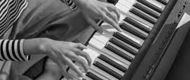
RESEARCH & INSIGHTS
01
BARRIERS IDENTIFIED
02
RESEARCH METHODS
03
KEY INSIGHTS
Boring, repetitive lessons.
Lack of real-time feedback.
Accessibility challenges for diverse learners.
Surveys and interviews with students, self-learners, and music teachers.
Competitive analysis of leading music education apps.
Users crave engaging, feedback-driven, and adaptable learning.
Accessibility is essential for inclusivity.

Slide 6
DESIGN FEATURES OVERVIEW
LANDING PAGE
LOGIN/REGSTER
HOME DASHBOARD
Welcomes users with a clean, minimalist intro and clear call-to-action.
Secure options, Google integration, and password recovery.
Personalized reminders, progress summaries, and mini-game access.
LESSONS
MINI GAME
PRACTICE TOOLS
Interactive modules for piano, guitar, drums, and more.
Fun, skill-building games with real-time feedback.
Practice Tools: Metrono
Metronome, tuner, chord library, and recording.

Slide 7
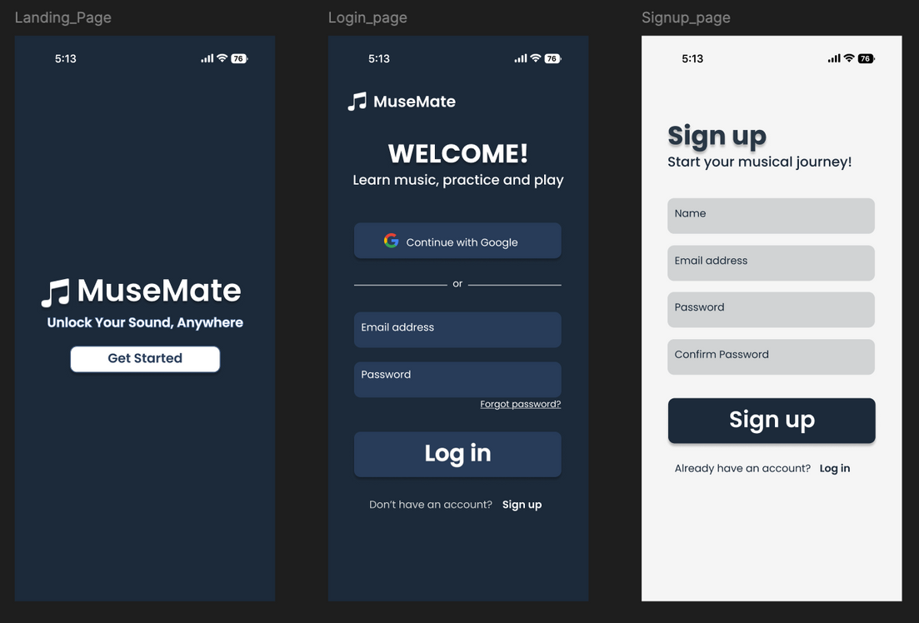
LANDING, LOGIN & SIGNUP PAGES
Landing
Log In
Sign Up
---> Blue-themed, uncluttered, with logo, slogan, and a prominent login/signup button.
---> “Welcome Back” message, Google login, email/password fields, password recovery, and a link to signup.
---> Clean white background, input fields for name, email, password, and confirmation. Clear call-to-action and easy navigation to login if already registered.

Slide 8
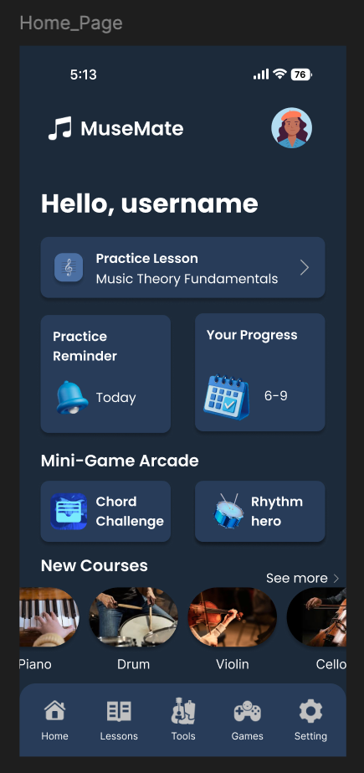
HOME DASHBOARD
Welcome message and user avatar/profile icon.
Practice Reminder card-set daily/weekly practice goals and notifications.
Progress Tracker card-shows lesson streaks, completed levels, and learning charts.
Mini-Game Arcade section-quick access to games like Chord Challenge and Rhythm Hero.
New Courses section-instrument-specific learning paths for Strings, Piano, and Drums.

Slide 9
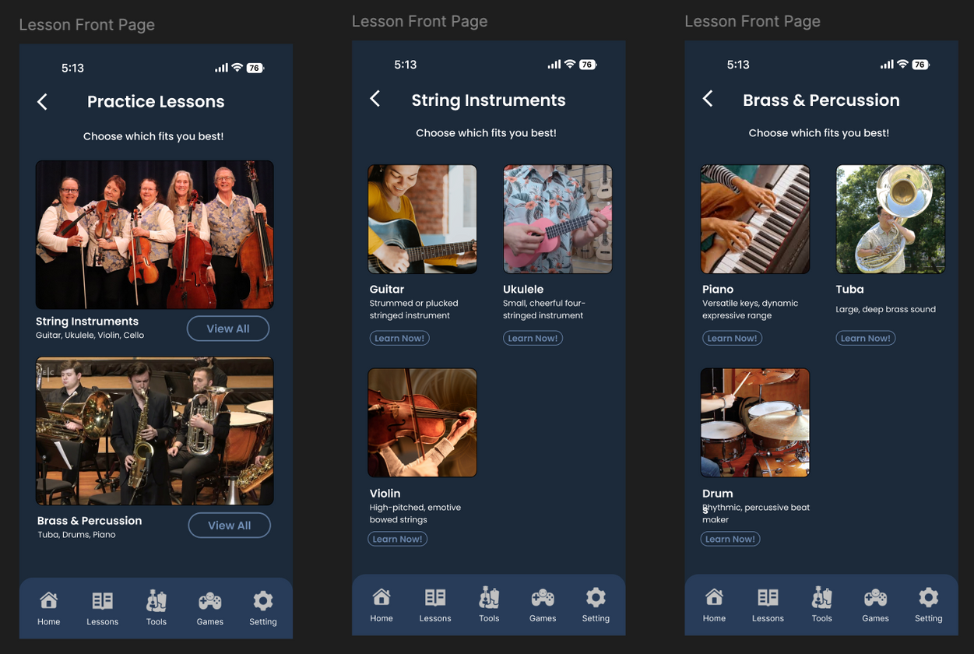
LESSONS - CORE MODULE
Landing
Choose between String Instruments (guitar, violin, cello, ukulele) and Brass & Percussion (tuba, drums, piano).
Guitar/Ukulele
Song lists, skill-based courses, chord/lyric displays, and easy navigation to practice and new songs.
Piano
Interactive virtual keyboard, real-time note feedback, beginner sheet music, and tap-to-play features.
Other Instruments
Drums
Virtual drum kit, tap to play, rhythm exercises, and beginner drum lessons.
Violin, cello, tuba-each with tailored lesson flows and interactive elements.

Slide 10
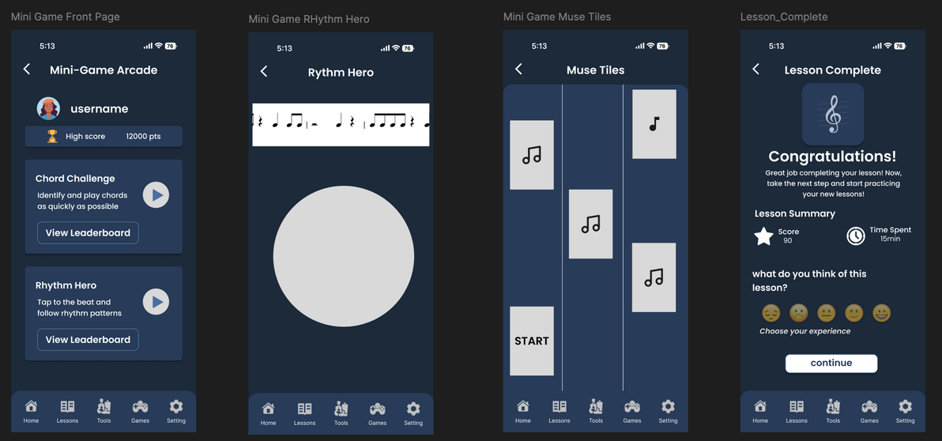
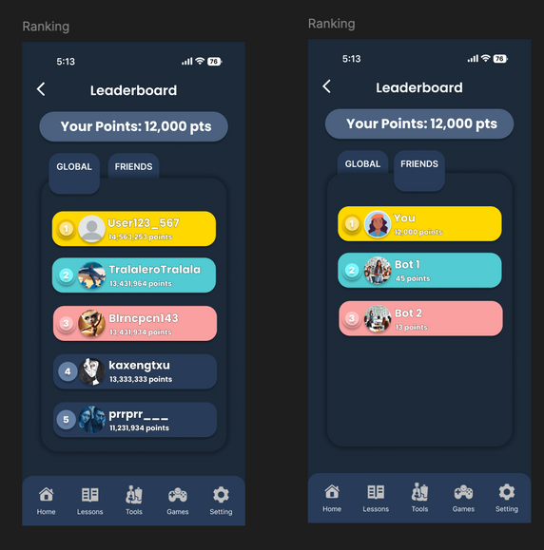
MINI GAME
Game Selection: Browse by skill level or instrument.
Gameplay: Simple, engaging UI with clear instructions and real-time scoring.
Performance Analysis: Immediate breakdown of accuracy, speed, and improvement areas.
Ranking/Leaderboard:
Global and friends leaderboards by instrument and score.
Track personal bests, earn badges, and challenge friends.

Slide 11
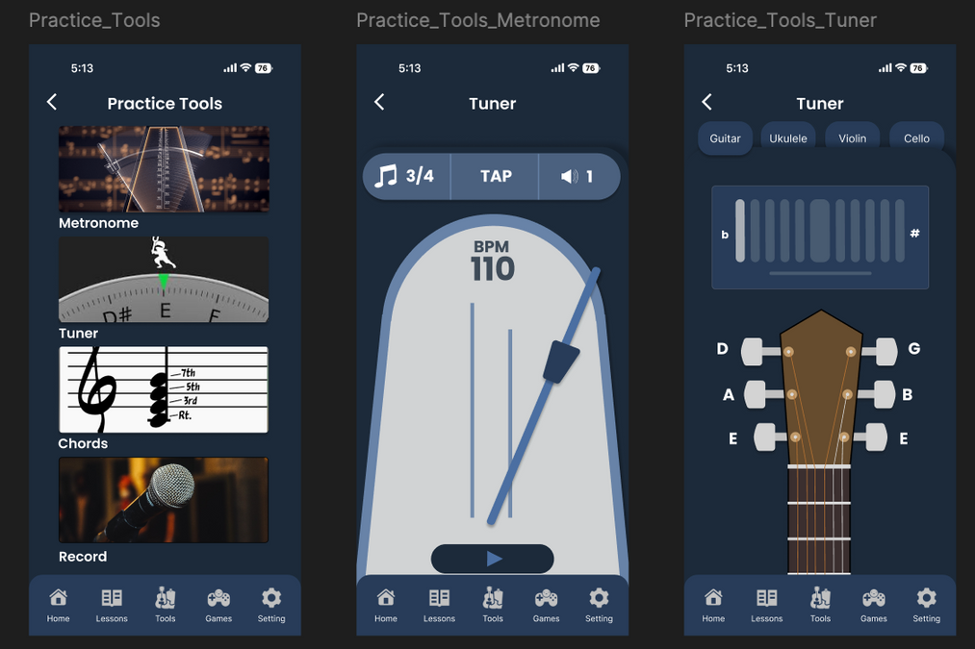
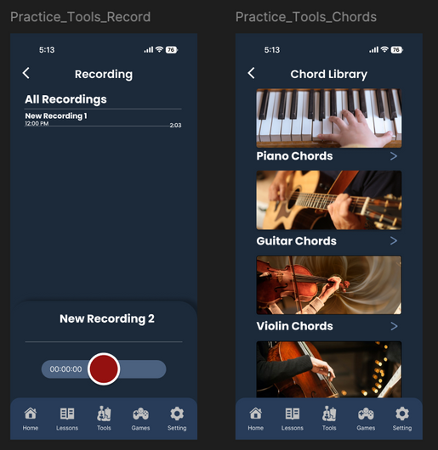
PRACTICE TOOLS
Metronome: Adjustable tempo and time signatures for rhythm practice.
Tuner: Visual feedback for tuning multiple instruments (guitar, ukulele, cello, violin).
Chord Library: Visual diagrams and audio playback for chords.
Recording: Capture, playback, and share practice sessions for self-evaluation.

Slide 12
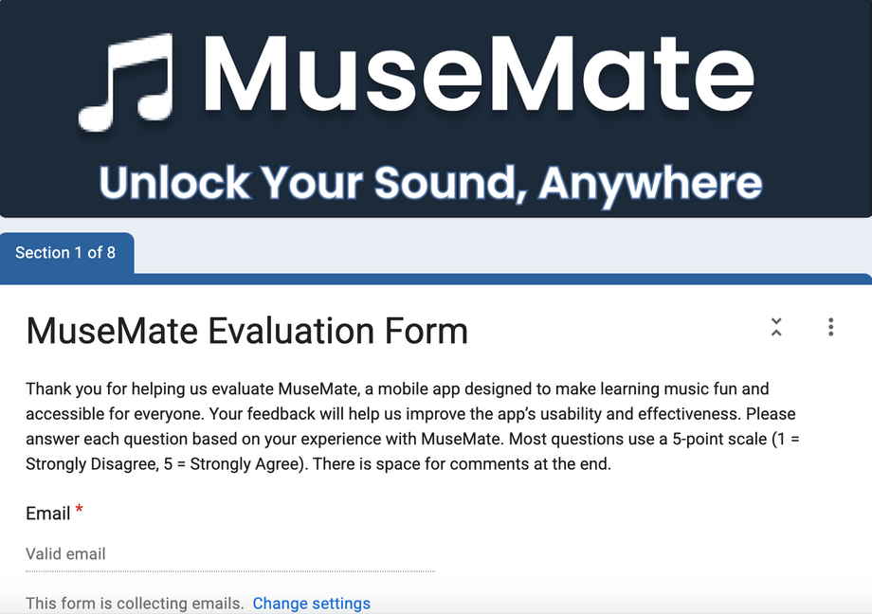
USER FEEDBACK
Method
Google form shared to 3 different people for user feedback.
Testing Insights
90% found instant feedback “very helpful.”
Most users completed onboarding in under 2 minutes.
Beginners reported feeling “confident” after their first lesson.
Areas of improve-ment
Users want more songs and video tutorials.
https://docs.google.com/forms/d/1CEusxS_Vlgs1SCjmsafEAdXPnKPWgZZcP2Z86h1lraE/edit

Slide 13

STRENGTHS
REFLECTION, TEAM & NEXT STEPS
Fun, adaptive, and inclusive learning; strong accessibility focus.
CHALLENGES
Balancing simplicity and feature richness; ensuring accessibility for all.
NEXT STEPS
More user testing, refining feedback, expanding instrument/game libraries.
TEAM ROLES
Designers: All members
Documenters: Phone Pyae & Dbjhane
Feature Leads: Dbjhane (Landing), Phone Pyae (Login/Signup/Home), All (Lessons), Dbjhane/Alleef (Practice Tools), Armon (Mini-Game/Ranking)

Slide 14
THANK YOU

